Slide 1

Transceivers for Wireless Sensor Networks (WSN) & IoT
Τηλεπικοινωνιακή Ηλεκτρονική Εαρινό Εξάμηνο 2020-2021
Σωκράτης Κοσέογλου
Ηλιάνα Δανιηλίδου

Slide 2

A Low-Power 2.4GHz ZigBee Transceiver with Inductor-less RF Front-end for IoT applications
ΙοΤ-WSN Basic Principles/ History/Wireless Technologies
A 4-GHz Low Power, Multi-User Approximate Zero-IF FM-UWB Transceiver for IoT
Implementing IoT/WSN based smart Saskatchewan Healthcare System

Slide 3


What is IoT?
Transceivers for Wireless Sensor Networks (WSN) & IoT
Internet of Things (IoT) is a system of devices connected to the Internet with the ability to collect and exchange data from users or environment with no human intervention.
1

Slide 4
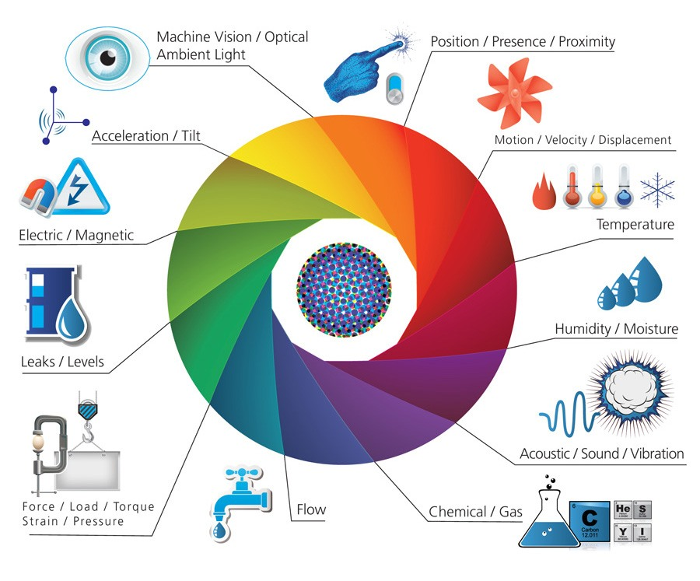
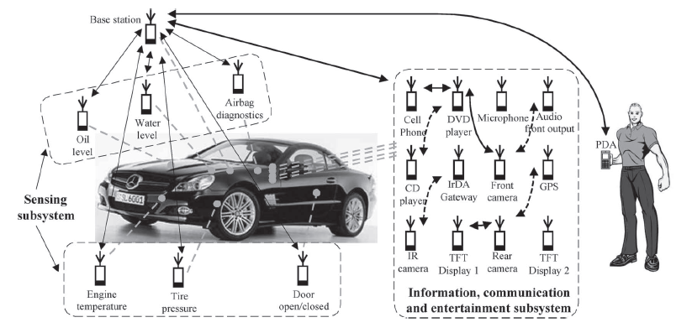
What is Wireless-Sensor-Network (WSN) ?
Transceivers for Wireless Sensor Networks (WSN) & IoT
Wireless sensor network (WSN) refers to spatially dispersed and dedicated sensors that monitor and record the physical conditions of the environment and forward the collected data to a central location
2

Slide 5
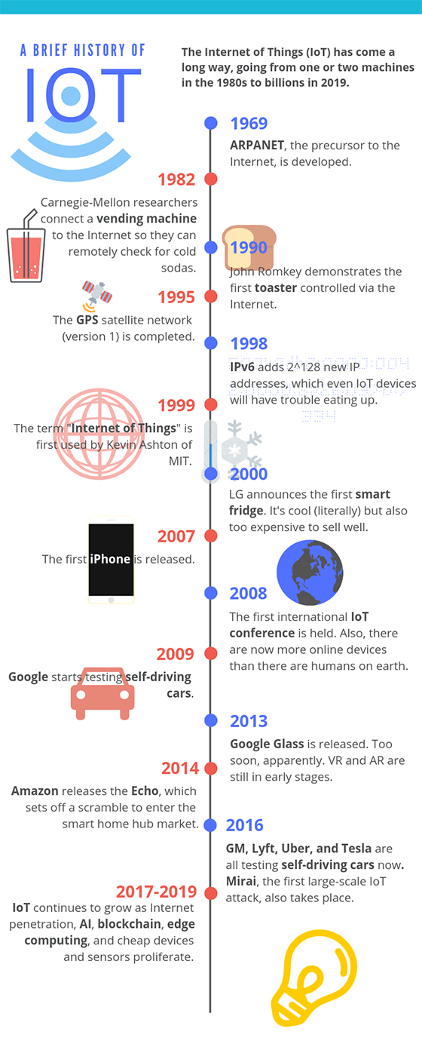
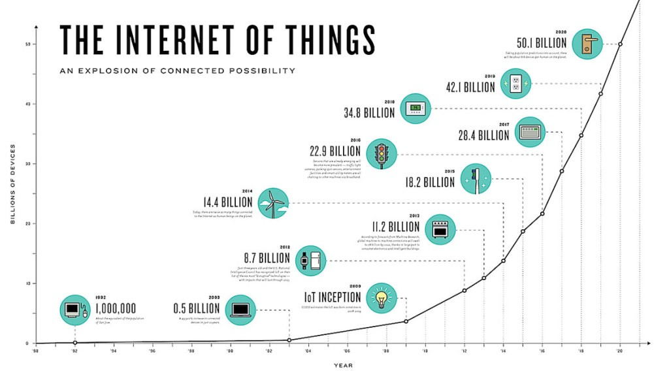
IoT Historic Timeline
Transceivers for Wireless Sensor Networks (WSN) & IoT
Some Important Dates
1982: Carnegie-Mellon researchers connect a vending machine to the Internet so they can remotely check for cold sodas.
1999: The term “Internet of Things” is first used by Kevin Ashton of MIT.
2000: LG announces the first smart fridge.
2008: The first international IoT Conference is held.
3

Slide 6
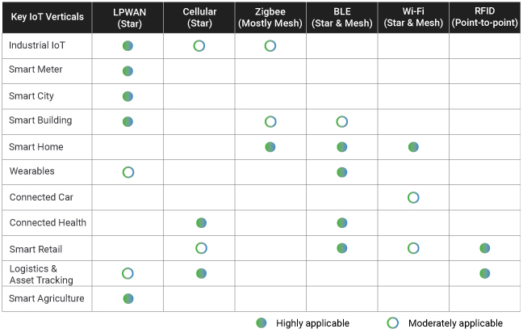
IoT Wireless Technologies
Transceivers for Wireless Sensor Networks (WSN) & IoT
LPWAN (Low Power Wide Area Networks)
Cellular (4G/5G)
Zigbee
Bluetooth & BLE (Bluetooth Low Energy)
WiFi
RFID
4

Slide 7
ΙοΤ-WSN Basic Principles/ History/Wireless Technologies
A 4-GHz Low Power, Multi-User Approximate Zero-IF FM-UWB Transceiver for IoT

Slide 8
Introduction
A 4-GHz Low Power, Multi-User Approximate Zero-IF FM-UWB Transceiver for IoT
Wireless traffic is increased, leading to congestion in commonly used bands
For short-range applications, Ultra-Wideband (UWB) Transceivers solve this problem
Lower Power Spectral Density (PSD)
Types of UWB Transceivers
Impulse Radio Ultra-Wideband (IR-UWB)
Frequency Modulated Ultra-Wideband (IR-UWB)
5

Slide 9
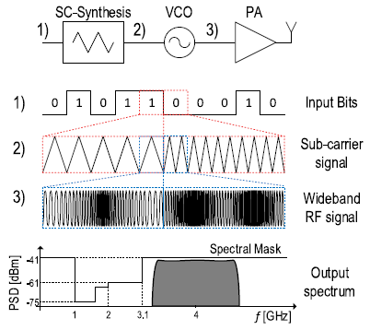
Frequency Modulated Ultra-Wideband (FM-UWB)
A 4-GHz Low Power, Multi-User Approximate Zero-IF FM-UWB Transceiver for IoT
Modulation is achieved in two steps
Input data are modulated onto triangular FSK sub-carrier (SC)
Then, the SC signal drives the Voltage-Controlled Oscillator (VCO)
FM-UWB Modulation Principle
6

Slide 10
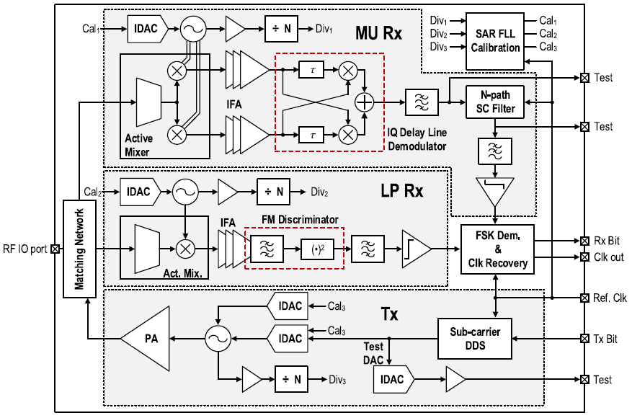
FM-UWB Transceiver General Architecture
A 4-GHz Low Power, Multi-User Approximate Zero-IF FM-UWB Transceiver for IoT
1 Transmitter & 2 Receivers
Multi-User (MU Rx)
Low Power (LP Rx)
Both for the transmitter & the receivers share a single RF IO pad
Both for the Modulation & Demodulation, a Ring Oscillator is used instead of Frequency Synthesizer
FM-UWB Transceiver Block Diagram
Tx Transmitter
Tx bit is converter in triangular FSK sub-carrier (SC)
Then the DAC converter drives the Ring Oscillator
Power Amplifier (PA) to amplify the signal
Calibration is done using a Frequency-Locked Loop (FLL)
7

Slide 11
FM-UWB Transceiver General Architecture
A 4-GHz Low Power, Multi-User Approximate Zero-IF FM-UWB Transceiver for IoT
Ring Oscillator for down-conversion of the signal
Active Mixer, instead of LNA
Then, the signal is amplified via an Intermediate Frequency Amplifier (IFA), before demodulation
MU Receiver
Targets better performance (throughput, latency)
Good FM-AM Linearity
FM-UWB Transceiver Block Diagram
Uses Quadrature Down Conversion & baseband delay-line demodulator
LP Receiver
Simplifies the receiver architecture/Low Power Consumption
Single Down-Conversion branch is used
The SC frequency doubles
8

Slide 12
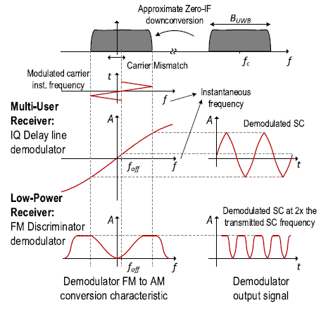
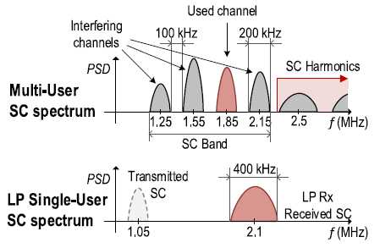
FM-UWB Demodulation Principle
A 4-GHz Low Power, Multi-User Approximate Zero-IF FM-UWB Transceiver for IoT
The MU Receiver demodulates well the Sub-Carrier (SC) signal
While the LP Receiver doubles the Sub-Carrier (SC) signal
FM to AM Demodulation
MU Receiver spans from 1.15 MHz to 2.3 MHz
4 SC Channels for 100 kbps
200 kHz Bandwidth and 100 kHz Spacing
LP Receiver has only one SC signal due to high non-linearity of FM-AM Conversion
SC Frequency Plan
9

Slide 13
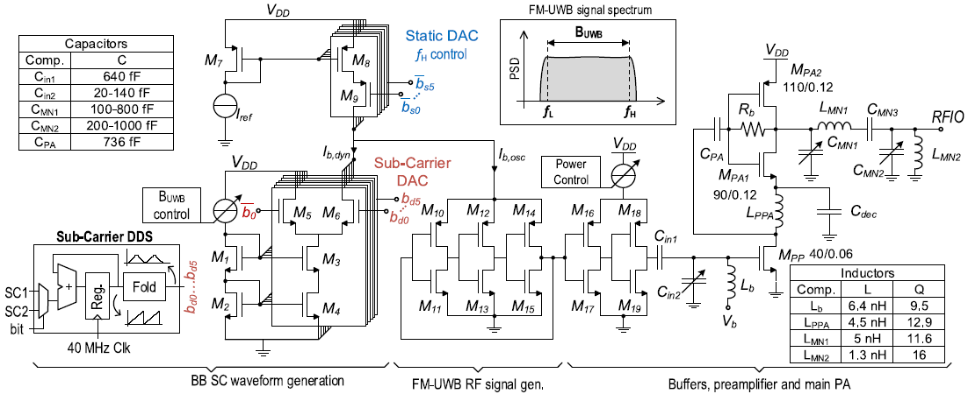
Transmitter Implementation
A 4-GHz Low Power, Multi-User Approximate Zero-IF FM-UWB Transceiver for IoT
Transmitter Transistor-Level Schematic
The SC-DDS provides a 6-bit signal
Static DAC provides a current that determines the maximum frequency
Sub-Carrier DAC produces the modulated RF FM-UWB signal
The bias current controls the Ring Oscillator
Three-stage Ring Oscillator, each stage is scaled with increasing transistors
Two inverters for isolation between the RO and the PA
Class AB Power Amplifier is used
10

Slide 14
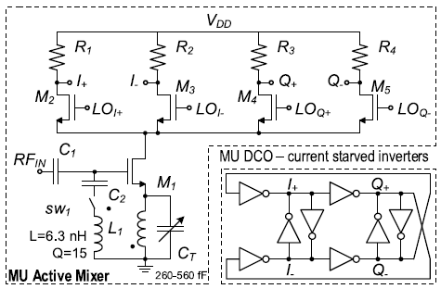
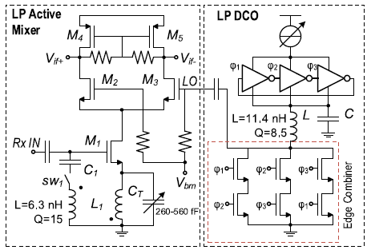
Receiver Implementation
A 4-GHz Low Power, Multi-User Approximate Zero-IF FM-UWB Transceiver for IoT
M1 Transistor provides voltage-to-current conversion (it can be seen as an LNA)
Two-stage differential ring oscillator to generate quadrature LO signals
RF Front End and LO generation of the MU Receiver
Active Mixer has a single LO input
The Local Oscillator (LO) consists of three inverters
The three generated phases are then combined in an edge combiner in order to triple the output frequency
RF Front End and LO generation of the LP Receiver
11

Slide 15
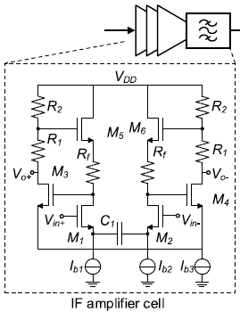
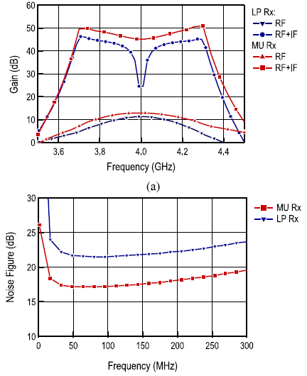
IFA (Intermediate Frequency Amplifier)
A 4-GHz Low Power, Multi-User Approximate Zero-IF FM-UWB Transceiver for IoT
Both receivers have an IFA, three stage Amplifier (each stage is implemented as a feedback Cherry-Hooper Amplifier)
IF Three Stage Amplifier
The capacitor C1 provides the high-pass part of the characteristic
IFA Gain Characteristic & Noise Figure
12

Slide 16
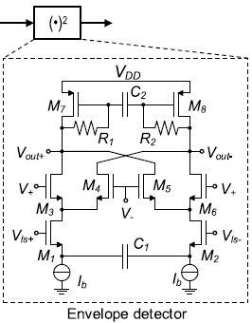
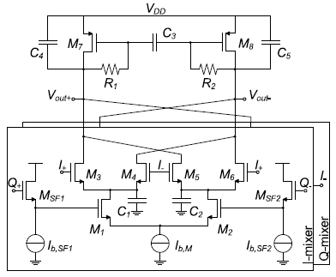
FM Demodulator
A 4-GHz Low Power, Multi-User Approximate Zero-IF FM-UWB Transceiver for IoT
Standard double balanced mixer
The signal is mixed with itself and the level shifters adjust the DC value of the input signal for the two inputs of the mixer
FM Demodulator of LP Receiver
A similar circuit is used for the MU Receiver, except that here we have two mixers
FM Demodulator of MU Receiver
Load of both demodulators is less than 20μA (usually 3mA)
13

Slide 17
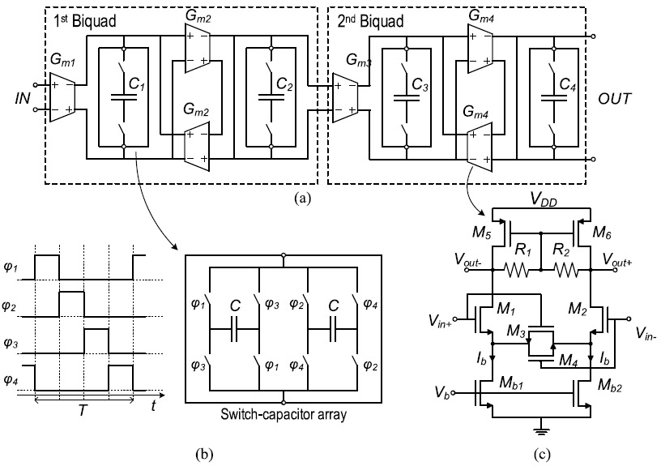
N-Path Filter
A 4-GHz Low Power, Multi-User Approximate Zero-IF FM-UWB Transceiver for IoT
MU Receiver supports up to 4 channels
Unwanted channels must be filtered before demodulation
N-Path Filters are good candidates, because of wide tuning and no additional off-chip components
Low Pass Filter -> Bandpass Filter
4th Order Type-1 Chebychev Filter
Two biquadratic sections
FM-UWB Transceiver Block Diagram
Each has the following transfer function $H\left(S\right)=\frac{H_{o}}{as^{2}+bs+1}$
N-Path Filter Circuit Schematic
$H_{o}=\frac{G_{m1}G_{m2}}{G_{m2}^{2}+G_{o1}G_{o2}} a=\frac{C_{1}C_{2}}{G_{m2}^{2}+G_{o1}G_{o2}}$ b$=\frac{C_{1}G_{o2}+C_{2}G_{o1}}{G_{m2}^{2}+G_{o1}G_{o2}}$
14

Slide 18
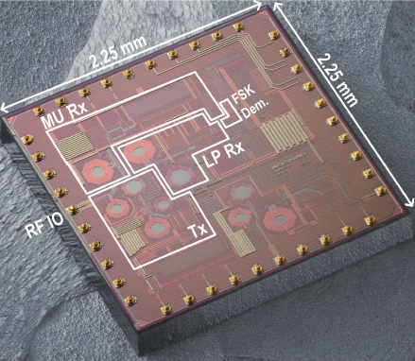
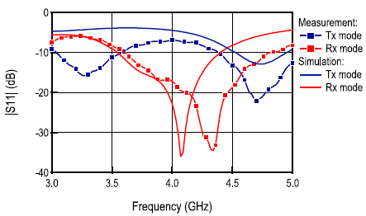
Measurement Results
A 4-GHz Low Power, Multi-User Approximate Zero-IF FM-UWB Transceiver for IoT
Die Size is 2.25mm x 2.25mm
The transceiver occupies roughly one-third of the die area
Die Photograph
Transmit mode -> S11 close to -8dBm
Receive mode -> S11 less than -10dBm (from 3.6G Hz to 4.8 GHz)
S11 parameter measurement
15

Slide 19
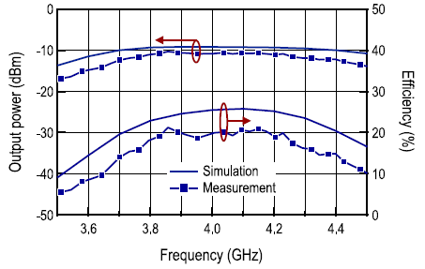
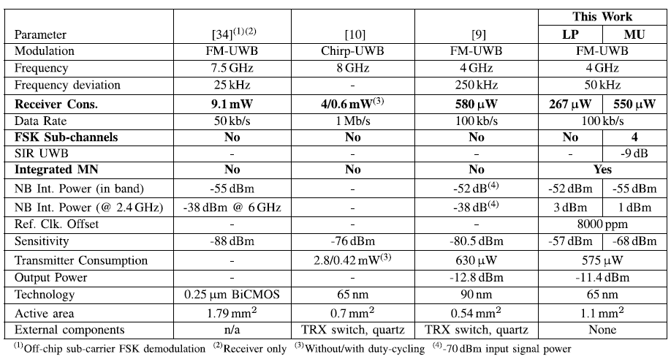
Measurement Results
A 4-GHz Low Power, Multi-User Approximate Zero-IF FM-UWB Transceiver for IoT
Output Power is slightly less than simulated
As a result, the efficiency also drops to peak value of about 21%
The achieved transmitter efficiency (output power / total power consumption) of 12.4% is better than any state-of-the-art.
Output Power & Efficiency of the Power Amplifier
[9] & [10] occupy less die area but require external components
[34] achieves good FM-AM linearity and can support multiple users but these features are not implemented in the chip itself
Comparison with State-of-the-art
16

Slide 20
A Low-Power 2.4GHz ZigBee Transceiver with Inductor-less RF Front-end for IoT applications
ΙοΤ-WSN Basic Principles/ History/Wireless Technologies
A 4-GHz Low Power, Multi-User Approximate Zero-IF FM-UWB Transceiver for IoT

Slide 21
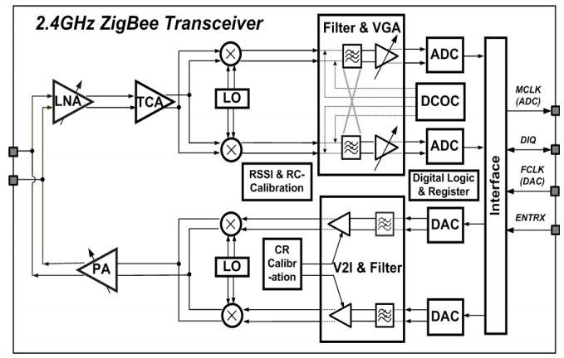
2.4GHz ZigBee Tranceiver
Transceivers for Wireless Sensor Networks (WSN) & IoT
ZigBee Technology -> one of the best candidates for the wireless sensor network and Internet of Things (IoT)
the inductor’s size doesn’t scale with the CMOS process, which consumes large chip area and dedicated thick-metal layers
=>
eliminating inductors from the RF front-end, while maintaining low-noise, high-linearity, and high efficiency transmission
Consists of a sliding FS with low-frequency running VCO and self-mixing LO generation, which achieves low power consumption and avoids frequency pulling from the transmitting PA.
The proposed transceiver is implemented in an 180nm CMOS and tested by cooperating with the digital baseband.
Architecture of the proposed ZigBee Transceiver
18

Slide 22
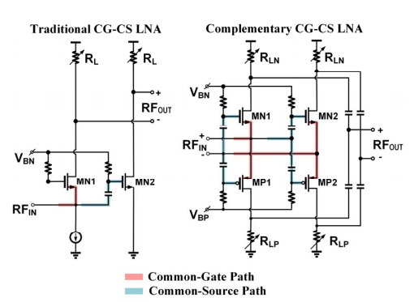
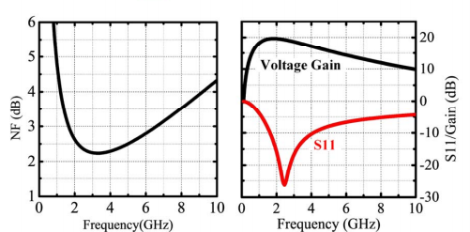
Inductor-less LNA
Transceivers for Wireless Sensor Networks (WSN) & IoT
Schematics of the traditional and the proposed CG-CS LNA, as well as the simulated NF, S11 and gain.
Simulation results show that the LNA achieves 2.3dB noise figure, 19.5dB voltage gain while dissipating 1.8mA current at 2.4GHz frequency band.
19

Slide 23
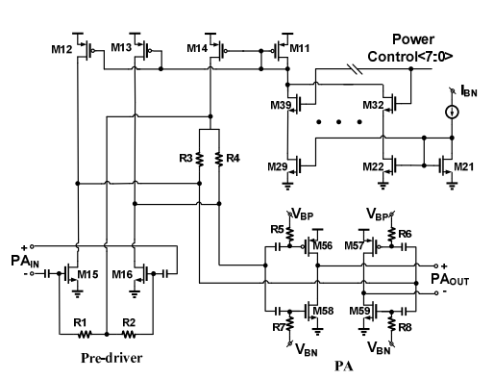
Inductor-less Power Amplifier
Transceivers for Wireless Sensor Networks (WSN) & IoT
A two-stage topology is adopted, in which the pre-driver features 200uA-4mA (20x) tuning range, while the PA stage has 1-8mA (8x) tuning range. The overall PA output power range covers from - 30dBm to +8dBm, which is break down into the two stages.
Two-stage inductor-less PA with power control.
20

Slide 24
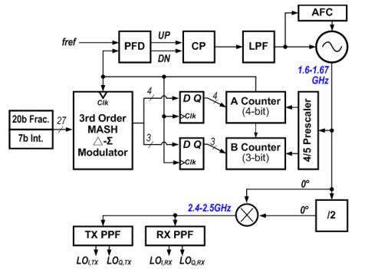
Frequency Synthesizer with 2/3LO frequency VCO
Transceivers for Wireless Sensor Networks (WSN) & IoT
The FS generates low phase noise local oscillator (LO) signals for the RX down-conversion and the TX upconversion, covering a 2.4~2.5GHz frequency range.
There are two design issues in the FS, respectively the frequency pulling by the large PA output and the power consumption.
VCO -> oscillate at a different frequency than the PA output
Frequency Synthesizer simplified block diagram.
21

Slide 25
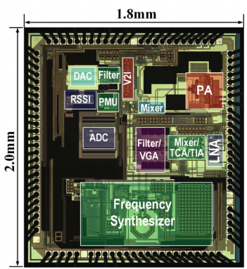
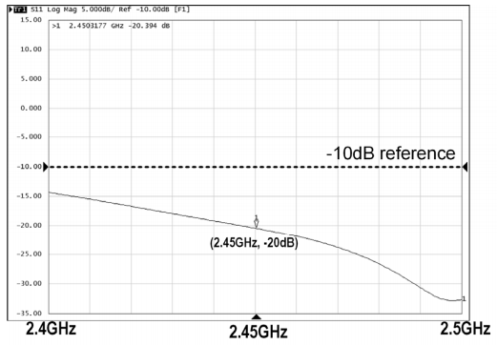
Measurement Results
Transceivers for Wireless Sensor Networks (WSN) & IoT
Input Matching
Input impedance matching of the RF front-end.
Die-photo of the ZigBee transceiver.
22

Slide 26
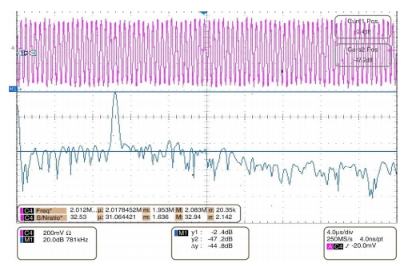
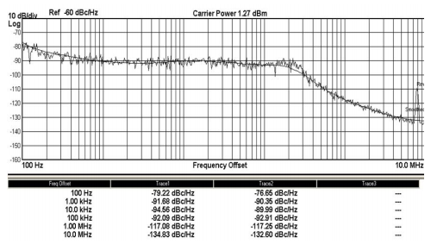
Measurement Results
Transceivers for Wireless Sensor Networks (WSN) & IoT
RX Sensitivity
Frequency Synthesizer
Reconstructed analog output of the receiver.
Measured synthesizer phase noise at 2.44GHz.
NF=Pin-10logBW-SNRout+174
23

Slide 27
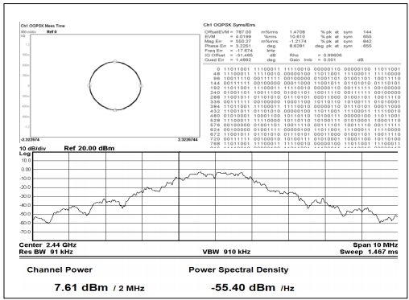
Measurement Results
Transceivers for Wireless Sensor Networks (WSN) & IoT
TX Transmission
Τhe measured OQPSK output power, constellation diagram and EVM.
The TX’s EVM is measured at 4%, while outputting 7.6dBm power.
Measured TX output spectrum, constellation and EVM.
24

Slide 28
A Low-Power 2.4GHz ZigBee Transceiver with Inductor-less RF Front-end for IoT applications
ΙοΤ-WSN Basic Principles/ History/Wireless Technologies
A 4-GHz Low Power, Multi-User Approximate Zero-IF FM-UWB Transceiver for IoT
Implementing IoT/WSN based smart Saskatchewan Healthcare System

Slide 29
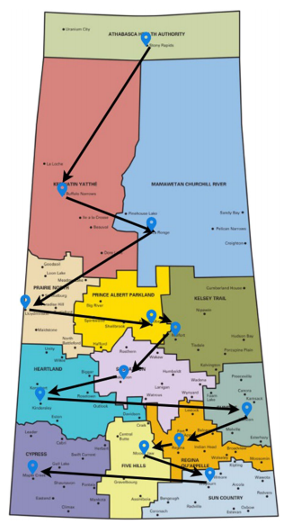
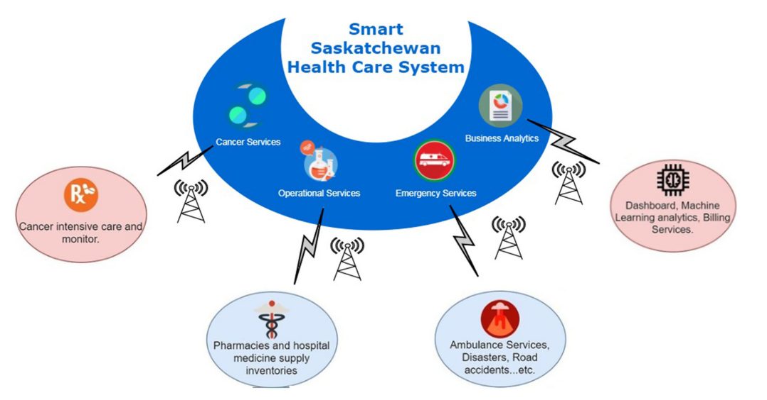
Smart Saskatchewan Healthcare System
Transceivers for Wireless Sensor Networks (WSN) & IoT
Smart Saskatchewan Healthcare System architecture
Saskatchewan health region network nodes
26

Slide 30
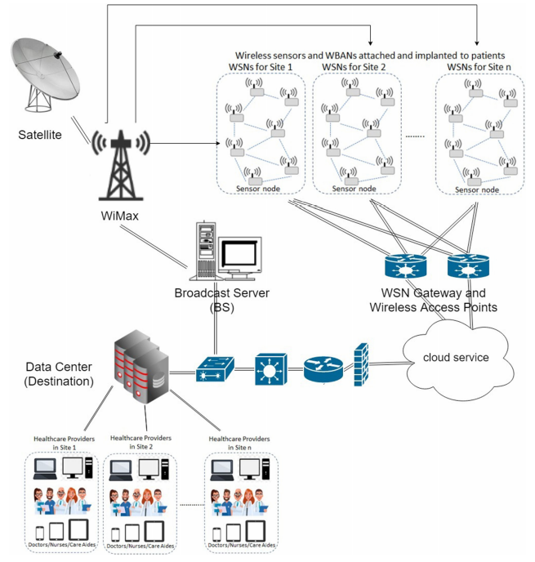
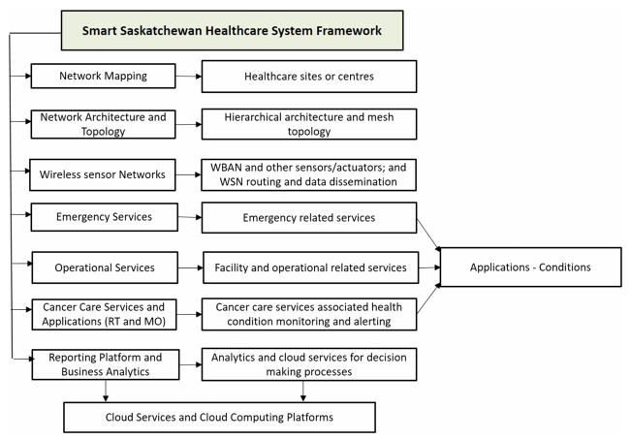
Transceivers for Wireless Sensor Networks (WSN) & IoT
IoT health solution/system framework
Hierarchical and location-based WSN routing
27

Slide 31
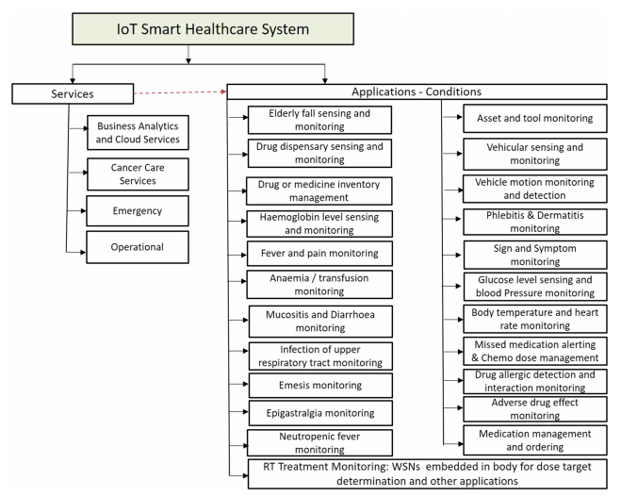
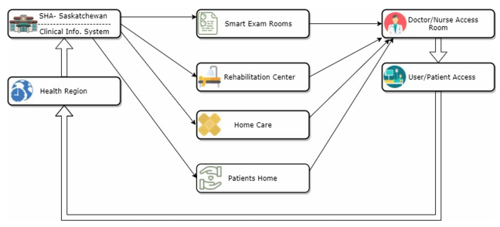
Transceivers for Wireless Sensor Networks (WSN) & IoT
Clinical environment interaction in smart system
IoT smart Saskatchewan healthcare services and applications
28

Slide 32
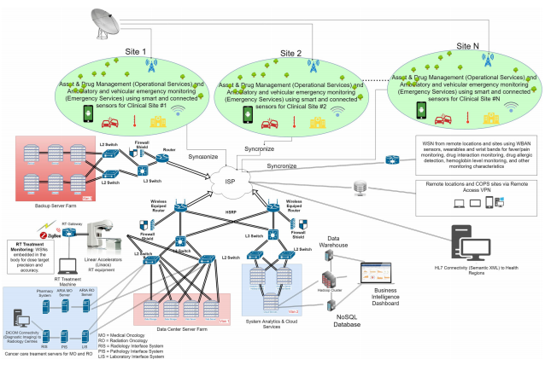
Full mesh smart Saskatchewan Healthcare System
Transceivers for Wireless Sensor Networks (WSN) & IoT
29

Slide 33
Βιβλιογραφία
Transceivers for Wireless Sensor Networks (WSN) & IoT
Vladimir Kopta, Christian C. Enz, “A 4-GHz Low-Power, Multi-User Approximate Zero-IF FM-UWB Transceiver for IoT”, IEEE JOURNAL OF SOLID-STATE CIRCUITS, VOL. 54, NO. 9, SEPTEMBER 2019
Bing Xia, Nan Qi, Liyuan Liu and Nanjian Wu, “A Low-Power 2.4GHz ZigBee Transceiver with Inductor-less RF Front-end for IoT applications”, 978-1-5090-6389-5/17/$31.00 ©2017 IEEE
Adeniyi Onasanya, Sari Lakkis, Maher Elshakankiri, “Implementing IoT/WSN based smart Saskatchewan Healthcare System”, Publiced Online: 02 January 2019
30

Slide 34

Thank you for your time!
Questions?

